Slide 1
Board of Directors
Cook County Land Bank Authority
Executive Director’s Report
Robert Rose, Executive Director
September 24, 2015
Notes:
This template can be used as a starter file to give updates for project milestones.
Sections
Right-click on a slide to add sections. Sections can help to organize your slides or facilitate collaboration between multiple authors.
Notes
Use the Notes section for delivery notes or to provide additional details for the audience. View these notes in Presentation View during your presentation.
Keep in mind the font size (important for accessibility, visibility, videotaping, and online production)
Coordinated colors
Pay particular attention to the graphs, charts, and text boxes.
Consider that attendees will print in black and white or grayscale. Run a test print to make sure your colors work when printed in pure black and white and grayscale.
Graphics, tables, and graphs
Keep it simple: If possible, use consistent, non-distracting styles and colors.
Label all graphs and tables.

Slide 2
Overview
This report covers updates on:
    Announcements
    Staffing Plan
    Focus Communities/Neighborhood Stabilization Initiative
    Core Business Activities
    Community Engagement
    Current Projects
    Future Projects
Notes:
What is the project about?
Define the goal of this project
Is it similar to projects in the past or is it a new effort?
Define the scope of this project
Is it an independent project or is it related to other projects?
* Note that this slide is not necessary for weekly status meetings

Slide 3
Announcements
On 8/10/2015, Citibank announced $1,000,000 donation to CCLBA. Funds were received on 9/4/2015
  Funds from the Department of Justice Settlement Agreement, Community Reinvestment and Neighborhood Stabilization Annex II, Section 4D “to capitalize The Cook County Landbank.”
  CCLBA considering several projects to leverage funding (Future Projects)
  Discussed at 9/17 Land Transactions Committee
Notes:
What is the project about?
Define the goal of this project
Is it similar to projects in the past or is it a new effort?
Define the scope of this project
Is it an independent project or is it related to other projects?
* Note that this slide is not necessary for weekly status meetings

Slide 4
Staffing Plan
Hired Accountant – start date 8/3/15
Hired Acquisition Specialist – start date 9/21/15
Hired Asset Manager – start date 10/5/15
Posting in September for 1 Acquisition Specialist and 1 Closing Specialist
Drafting job descriptions for Deputy Director and Public Information Officer
Current Team (6)
Acquisition Specialist (1)
Nov 2015
Asset Manager (1)
Oct 2015
Closing Specialist (1)
Nov 2015
PIO (1)
Dec 2015
Deputy Director (1)
Dec 2015

Slide 5
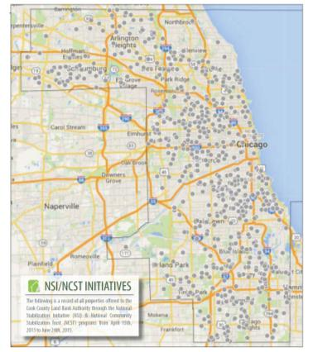
NSI Update
1,288 properties presented via NSI/NCST from April 15 – August 31, 2015
260 properties located in CCLBA Focus Communities (20.2% of properties)
  In contrast, 39% of all 2013/2014 foreclosures were in focus communities
416 offers submitted, 289 received (47.5% of properties located in Focus Communities (down from 88.2%, less properties offered in Focus Communities, working to expand scope) Plan is to be at 75%+ level.
77 offers accepted; 147 offers countered; 123 offers pending
  165 offers declined
  17 offers awarded to other buyers

Slide 6
Core Business Activities
2015 Core Business Activities (Dec 1, 2014 – August 31, 2015)
 | Prospects | In Progress | Completed | 2015 Output Goals | % Goal
Acquisition | 196 | 88 | 50 | 200 | 25%
Disposition | 45 | 31 | 13 | 75 | 17%
Demolition | 56 | 7 | 4 | 10 | 40%
Rehab | 44 | 12 | 1 | 10 | 10%
Proposed 2016 Outcomes
Two measures of CCLBA effectiveness. Targets will be developed for 2016.
    Market Capitalization Value – the difference between the CCLBA sales price and the end-user sales price. Represent real value added to the community.
    Incremental Tax Benefit – the amount of tax collected from previously tax-delinquent properties. Represents “extra” tax dollars generated by the community.

Slide 7
Community Engagement
July 2015 Meetings
Event/Meeting | Description | Date | Attended
Byline Bank | Discussion on REO portfolio and strategies and opportunities for collaboration | 7/7/15 | R. Rose, E. Williams
South Suburban Mayors and Managers Association | Met with various IL AG grantees to discuss progress/activities regarding blight reduction | 7/14/15 | R. Rose
City of Chicago Heights | Met with municipality to discuss IHDA Blight Reduction Program | 7/14/15 | R. Rose
Village of Country Club Hills | Met with Mayor Ford to discuss Focus Communities Program | 7/14/15 | R. Rose
Village of Riverdale | Met with village trustees to discuss IHDA Blight Reduction Program | 7/14/15 | R. Rose
Chicagoland Black Chamber of Commerce | Discussion on strategies for collaboration | 7/16/15 | R. Rose
Alderman David Moore | Met to discuss vacant properties in the 17th Ward | 7/20/15 | R. Rose
Alderman Roderick Sawyer | Met to discuss vacant properties in the 6th Ward | 7/23/15 | R. Rose
Endeleo Institute | Discussion on strategies on how to collaborate | 7/27/15 | R. Rose

Slide 8
Community Engagement
August 2015 Meetings
Event/Meeting | Description | Date | Attended
Mt. Ebenezer Church (w/ Commissioner Richard Boykin) | Met with various Westside ministers on how to engage with CCLBA and opportunities for collaboration | 8/5/15 | R. Rose
Growing Home | Discussion on strategies for collaboration | 8/11/15 | R. Rose
Illinois Grassroots Coalition | Met with group on how to engage with CCLBA and opportunities for collaboration | 8/12/15 | R. Rose
Chicago Rehab Network | Discussion on strategies for collaboration with The PrivateBank | 8/13/15 | R. Rose
Commissioner Robert Steele | Met to discuss vacant properties in the 2nd District | 8/14/15 | R. Rose
City of Harvey | Discussion on strategies for collaboration; submitted MOU | 8/25/15 | R. Rose
IFF | Met to discuss various properties in the South Suburbs | 8/26/15 | R. Rose
Alderman Joe Moore | Met to discuss vacant properties in the 49th Ward | 8/27/15 | R. Rose
Little Village Brownsfield Tour | Little Village Environmental Justice Organization-guided tour of the neighborhood | 8/28/15 | R. Rose

Slide 9
Community Engagement
September 2015 Meetings
Event/Meeting | Description | Date | Attended
City of Chicago Heights | Guided tour of the City with Mayor’s aide and Economic Development consultant | 9/1/15 | R. Rose
The PrivateBank Tour (w/Chicago Rehab Network) | Met with several developers interested in becoming eligible developers with TPB | 9/1/15 | R. Rose
Community Male Empowerment Project | Met with group on how to engage with CCLBA and opportunities for collaboration | 9/2/15 | R. Rose
Village of Ford Heights (w/Cook County Dept of Bldg and Zoning) | Met with Mayor Griffin to strategies for collaboration on vacant building ordinance | 9/4/15 | R. Rose
Rebuilding Exchange | Discussion on strategies for collaboration | 9/9/15 | R. Rose
Chesterfield Community Council (w/ City of Chicago Dept of Planning and Development) | Met with group on how to engage with CCLBA and opportunities for collaboration with City of Chicago | 9/10/15 | R. Rose
UIC Urban Forum | Attended various workshops on the social contract for health, energy and the environment | 9/17/15 | R. Rose
Windshield Surveys (w/Cook County Dept of Planning and Development) | Site visits to Ford Heights and Riverside Lawn | 9/17/15 | R. Rose

Slide 10
Current Projects
Project Status Report
Project Name | Address | Action Item
Granville Condominiums | 1054-1070 W. Granville Chicago, IL | Condo Association is ready to assign their lien to the CCLBA.
Bellwood – MiniMoves | 2150-54 Madison Bellwood, IL | CCLBA acquired the property in June of 2015. CCLBA has retained a real estate broker. Negotiating a recent offer.
Martin Memorials LLC | 7346-54 S. Cottage Grove Chicago, IL | Clyde Martin executed the purchase/sale agreement and submitted earnest money.
Riverside Lawn (Voluntary buyout of homes in flood-prone area) | Various address in unincorporated Cook County | Held town hall meeting in July. Strong interest in buyout. Sent letter and interest forms. Coordinating with MWRD/BOED.
PrivateBank Partnership |  | First home completed, several more in pipeline. Looking to add more eligible developers and to build develop capacity-building assistance with Chicago Rehab Network.

Slide 11
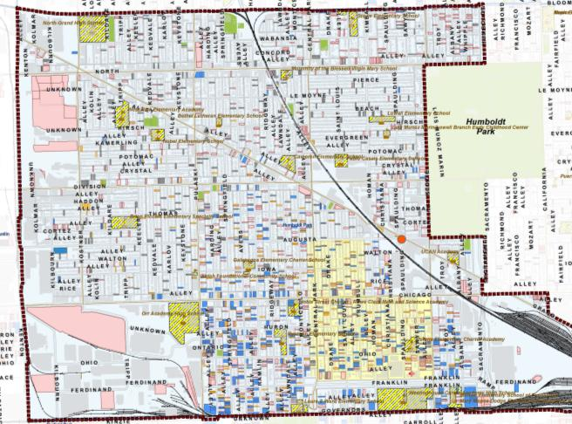
Neighborhood Strategy:
Humboldt Park
Strategies : Commercial investment, blight reduction program, MMRP, NHS Superblock
Partners: LUCHA, NHS, ICON, West Humboldt Park Family Development Center, MPC

Slide 12
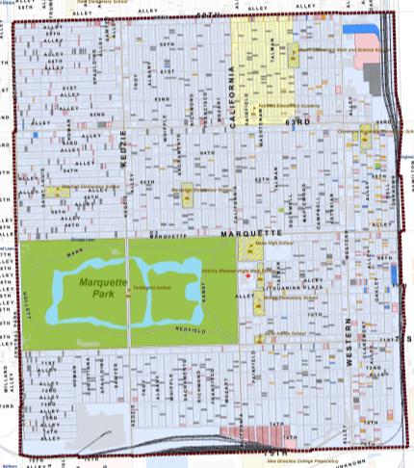
Neighborhood Strategy:
Chicago Lawn
Strategies : Residential purchase/rehab, blight reduction program, MMRP
Possible Partners: South West Organizing Project, Brinshore

Slide 13
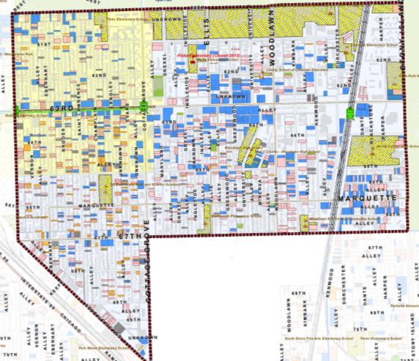
Neighborhood Strategy:
Woodlawn
Strategies: Tax forfeiture, blight reduction program, MMRP
Partners: Sunshine Gospel Ministries, Blacks In Green, The Woodlawn Organization, Greater Southwest Development Corporation

Slide 14
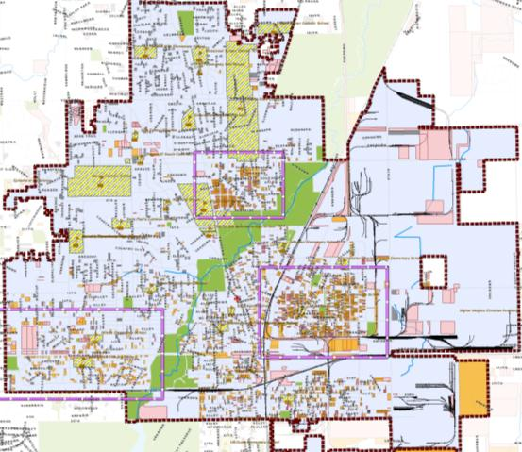
Neighborhood Strategy:
City of Chicago Heights
Strategies : Industrial investment, blight reduction program, tax forfeiture
Partners: City of Chicago Heights, South Suburban Land Bank and Development Authority, South Suburban Mayors and Managers Association, Forest Preserve

Slide 15
Neighborhood Strategy:
Land Transactions Committee Input
Leverage is important. Become a line item within a larger development.
Partnerships are key. CCLBA cannot do it alone.
Consider using the CitiBank donation to build capacity, i.e. – hire commercial/industrial acquisition specialist, tax sales expert, etc.

